Slide 1
Enterprise patterns

Slide 2
Bibliography
Martin Fowler
  Bliki: http://martinfowler.com/eaaCatalog/
  Patterns of Enterprise Application Architecture
Enterprise Solution Patterns Using Microsoft .NET
  http://msdn.microsoft.com/en-us/library/ff647095.aspx
CQRS:
  http://martinfowler.com/bliki/CQRS.html
  http://msdn.microsoft.com/en-us/library/jj591573.aspx
  http://en.wikipedia.org/wiki/Command-query_separation

Slide 3
Enterprise Applications
persistent data
a lot of data
access data concurrently
a lot of user interface screens
integrate with other enterprise applications
conceptual dissonance – object change meaning (provided data) depend on departnemt
scalability
complex business logic
evolution of requirements

Slide 4
“A complex system that works is invariably found to have evolved from a simple
system that worked…A complex system designed from scratch never works and
cannot be patched up to make it work. You have to start over with a working
simple system.” — John Gall

Slide 5
Patterns are useful to developers and
architects because they:
document simple mechanisms that work.
provide a common vocabulary and taxonomy for developers and architects.
enable solutions to be described concisely as combinations of patterns.
enable reuse of architecture, design, and implementation decisions.

Slide 6
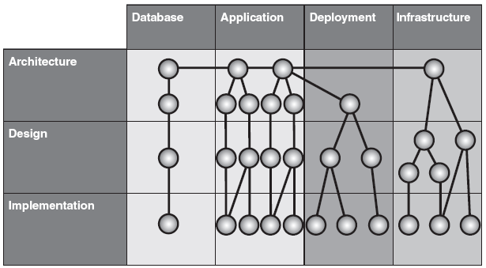
Patterns classification

Slide 7
Patterns classification
Architecture Patterns
These patterns describe how to structure an application at the highest level, expresses a fundamental structural organization schema for software systems. It provides a set of predefined subsystems, specifies their responsibilities, and includes rules and guidelines for organizing the relationships between them.
e.g. Layered Application

Slide 8
Patterns classification
Design Patterns
A design pattern provides a scheme for refining the subsystems or components
of a software system, or the relationships between them. It describes a commonly
recurring structure of communicating components that solves a general design
problem within a particular context.
e.g. Model View Controller

Slide 9
Patterns classification
Implementation Patterns (idioms)
An implementation pattern is a low-level pattern specific to a particular platform.
An implementation pattern describes how to implement particular aspects of components or the relationships between them, using the features of a given platform.

Slide 10
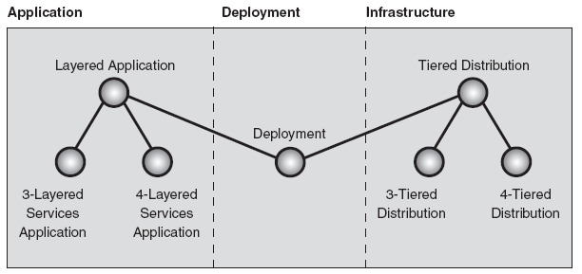
Deployment Patterns
“What do you mean it doesn’t run in production? It ran fine in the development environment.”
Anonymous developer
Reduction the tension between the teams by offering guidance on how to optimally structure your applications and technical infrastructure to efficiently fulfill the solution’s requirements.
Mapping the software structure to the hardware infrastructure.

Slide 11
Layered Application
You are designing a complex enterprise application that is composed of a large number of components across multiple levels of abstraction.
How do you structure an application to support such operational requirements as maintainability, reusability, scalability, robustness, and security?
Way in direction of decomposition and extraction of subsystems.
Separation and decoupling of components.
Improving testability, scalability, reusability.
Layers know only about layers just below them (only vertical communication) - cost of communication.
Indirect communication with data source may lengthen response time.
Adds complexity to simple application.

Slide 12
Three-Layered Services Application
You want to expose some of the core functionality of your application as services (UI) that other applications (users) can consume, and you want your application to consume services exposed by other applications.
How do you layer a service-oriented application and then determine the components in each layer?

Slide 13
You always want to minimize the impact of adding services to an existing application.
Services are often exposed to clients outside the corporate firewall, and therefore have different security and operational requirements than do business components.
Communicating with other services involves significant knowledge of protocols and data formats.
You want to separate the concerns of your components so that you are only changing them for one reason, such as to isolate your business logic from the technology required to access an external service.

Slide 14
Decomposition system to fallowing layers:
Presentation. The presentation layer provides provision of services, the application’s (UI), . Typically, this involves the use of Windows Forms for smart interaction, and ASP.NET technologies for browser-based interaction.
Business. The business layer implements the business functionality application. Logic that is the real point of the system.
Data The data layer provides access to external systems, communication with databases, messaging systems, transaction managers, other packages. Primary .NET technology involved at this layer is ADO.NET.
Three layers may be insufficient for complex UI or bussiness logic. Decomposition to multilayer system.
Notes:
Further discussion is certained around patterns for these three primary layers.

Slide 15
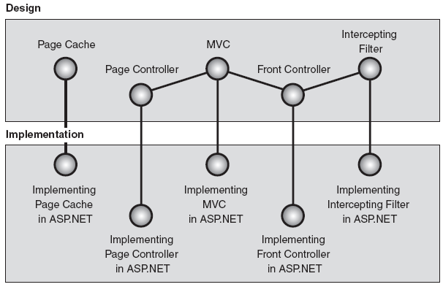
Web presentation patterns
MVC, MVP and its modifications:
http://ctrl-shift-b.blogspot.com/2007/08/interactive-application-architecture.html

Slide 16
Model View Controller
How to modularize the user interface functionality of a Web application so that you can easily modify the individual parts?
User interface logic tends to change more frequently than business logic.
Application may present the same data in different view/wey.
Different skill sets required for efective design HTML pages and complex bussiness logic.
Two types of activities: presentation and update.
Creating automated tests for interface is more complex than for domain logic.

Slide 17
Model manages the behaviour and data of the application domain, responds to request for information about the state and responds to instruction to change state.
View manages the display of informations.
Controller interprets the mouse and keyboard inputs from the user, inform the model and/or view to change as appropriate.
Implementation with inverse of control.
Supports multiple views and new types of clients.
Re – use of model componets.
Accomodates change.
Complexity.
Cost of frequent updates, frequent changes of model could flood the views.

Slide 18
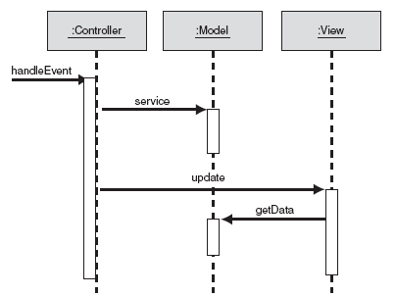
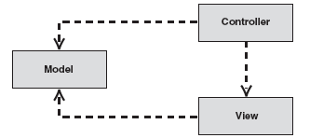
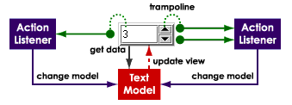

Slide 19
Page Controller
How do you best structure controller for moderately complex Web applications so that you can achieve reuse and flexibility while avoiding code duplication?
Decoupling view and controller in thin client because of acting on different phisical tier.
User action can lead to different controller followed by the same page presentation.
Extraction of recursing actions like parameters retrieving from quaery string, gathering session informations.
Common appearence and navigation.

Slide 20
Simplicity – each dynamic Web page is handled by a specific controller.
Build-in framework features.
Increased reuse – controller base class reduce duplication.
Expandability by helper class.
Separation of developer responsibilities.
Problem with dynamic configuration of pages and navigation maps between them.
Deep inherence trees.

Slide 21
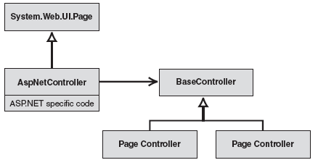

Slide 22
Front Controller
How do you best structure controller for very complex Web applications so that you can achieve reuse and flexibility while avoiding code duplication?
Cenralize logic to reduce amount of code duplication.
Retrieval of data in one location.

Slide 23
Centralized control – easier cross page action and action for all pages (security).
Smaller class tree without conditional page dependent logic for controller base class.
Configurability.
Improves manageability of security
Performance problems.
Increased complexity.

Slide 24
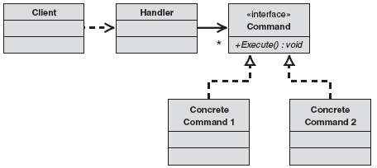
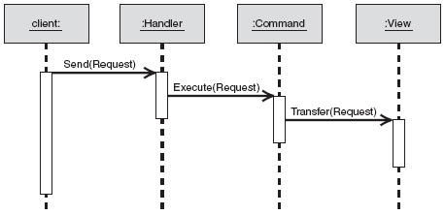

Slide 25
MVC modifications
The Model-View-Presenter Pattern
The Supervising Controller Pattern
The Passive View Pattern
Template view - renders information into HTML by embedding markers in an HTML page (ASP.NET ).
Transform view - A view that processes domain data element by element and transforms it into HTML (XSLT).
Two step view - turns domain data into HTML in two steps: first by forming some kind of logical page, then rendering the logical page into HTML.
Application controller – centralized point to hold screen navigation and application flow.

Slide 26
Intercepting Filter
How do you implement common pre- and post-processing steps around Web page request?
Many pre- and post-processing steps are common to all Web page (security, character encoding, cookies).
They are not dependent on each other.
Reusing pre- and post-processing functionalities in other applications.

Slide 27
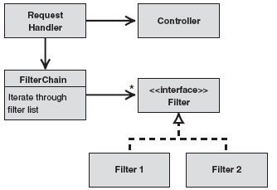
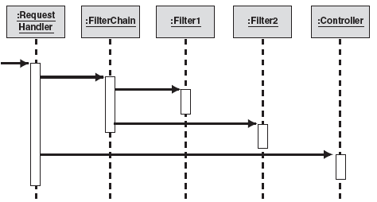
Separation of concerns.
Flexibility.
Central configuration.
Reuse.
Order dependency problems.

Slide 28
Inversion of control
Instead of specifying function calls, a series of events to happen during the lifetime of a program, rather register desired responses to particular happenings, and then let some external entities take control over the precise order and set of events to happen.
"Don't call us, we'll call you".
Delegates
Event-driven programming.
Growing complexity and ambiguity of code.
Separating configuration from use.
Large flexibility.

Slide 29
Domain logic patterns

Slide 30
Transaction script
Organizes business logic by procedures where each procedure handles a single request from the presentation.
Easy implementation, hard to expand to more complex bussiness model.
It works well with a simple data source layer using Row Data Gateway or Table Data Gateway.
It's obvious how to set the transaction boundaries: Start with opening a transaction and end with closing it. It's easy for tools to do this behind the scenes.
Duplicated code as several transactions need to do similar things, method does all the work.
Problem with modules coupling and scalability while growing application complexity.

Slide 31
Domain Model
An object model of the domain that incorporates both behavior and data.
Work is spreaded betwean objects.
Handle increasingly complex logic in a well-organized way.
Large initial cost, easy expand to complex bussiness logic.
Complexity of using.
It works well with a complex data source layer: Data Mapper.

Slide 32
Table module
A single instance that handles the business logic for all rows in a database table or view.
Middle ground between a Transaction Script and Domain Model.
Is designed to work with a Record Set.
Organizing the domain logic around tables rather than straight procedures provides more structure and makes it easier to find and remove duplication.

Slide 33
Data source architectural patterns

Slide 34
Table Data Gateway
An object that acts as a Gateway to a database table. One instance handles all the rows in the table.
A Table Data Gateway holds all the SQL for accessing a single table or view: selects, inserts, updates, and deletes. Other code calls its methods for all interaction with the database.
Common interface to SQL and stored procedures.
Good decoupling.
Implementation of properties due to neccesities.
Good choise fot Table Module
Data Set pattern (in memory representation of rows from table) for holding results of queries.
Approach widely used in .NET

Slide 35
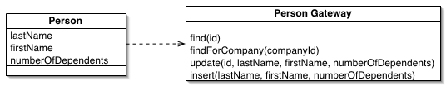

Slide 36
Row Data Gateway
An object that acts as a Gateway to a single record in a data source. There is one instance per row.
A Row Data Gateway gives you objects that look exactly like the record in your record structure but can be accessed with the regular mechanisms of your programming language. All details of data source access are hidden behind this interface.
Problem with multiple instanties of the same record (Identity map).
Need implementation of accessor to all properties.
Fit to Transaction Script (lower decoupling than Table Data Gateway).
Good candidate for code generation based on a Metadata Mapping and Data Mapper

Slide 37
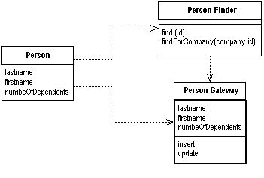

Slide 38
Active Record
An object that wraps a row in a database table or view, encapsulates the database access, and adds domain logic on that data.
An object carries both data and behavior. Much of this data is persistent and needs to be stored in a database. Active Record uses the most obvious approach, putting data access logic in the domain object. This way all people know how to read and write their data to and from the database.
Problem with multiple instanties of the same record (Identity map).
Problems with mapping relations to references (Foregin Key Mapping).
Problems with inherient and collections.
Implemented behavior: static finders, creation new record and insertion, deletion, updates, properties accessors, part of business logic.
Fit to Domain Model and not to complex data.

Slide 39
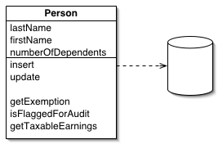

Slide 40
Data Mapper
A layer of Mappers that moves data between objects and a database while keeping them independent of each other and the mapper itself.
Gets data from the database (directly or indirectly) and populate the fields or properties of an object
Aquires data from objects and provide this data (directly or indirectly) to SQL statements or stored procedures
Strong decoupling and isolation bussines logic and database.
Yet another level of complexity
Fit to Domain Model.
Identity Map for prevent dublers.
Lazy Load for resolving references.

Slide 41
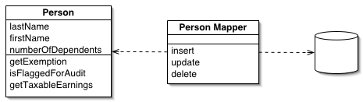
Implementation approache
Hard Code the Mapping Logic
Use Code Generation to Create Classes That Do the Mapping
Use Metadata and Reflection

Slide 42
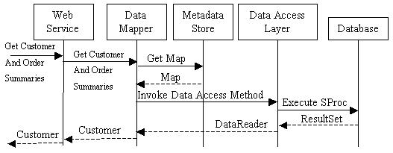
Retraving data from database.

Slide 43
Object-relational behavioral patterns

Slide 44
Unit of work
Maintains a list of objects affected by a business transaction and coordinates the writing out of changes and the resolution of concurrency problems.
Agregating database call for growing performance.
Transaction and concurency problems with in-memory objects.
Consistency between in-memory object and database.
Variation: caller registration, object registration, unit of work controller.
Buildin in .NET

Slide 45
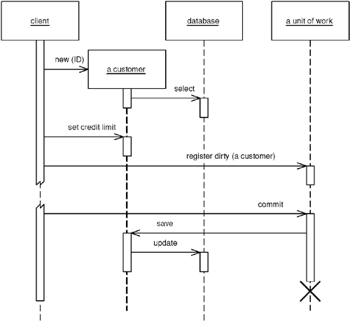
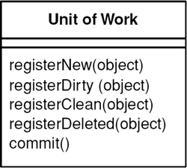

Slide 46
Identity Map
Ensures that each object gets loaded only once by keeping every loaded object in a map. Looks up objects using the map when referring to them.
Prevent from dublers.
Prevent from unneccesery databasecall, check identity map for object before call to database.
Problems with concurency.

Slide 47
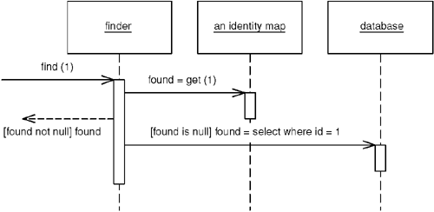

Slide 48
Object-relational structural patterns

Slide 49
Identity Field
Saves a database ID field in an object to maintain identity between an in-memory object and a database row.
Problem with getting value for new object (auto-generated field).

Slide 50
Foreign Key Mapping
Maps an association between objects to a foreign key reference between tables.
Single pointer stored in attribute represents mapping between source and target objects.

Slide 51
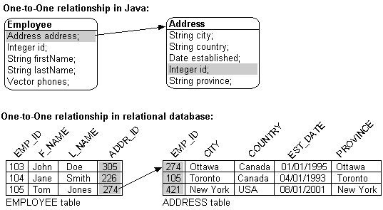
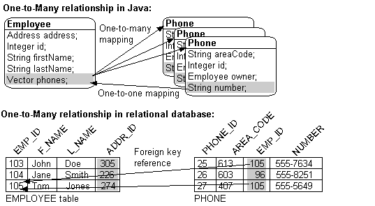

Slide 52
Association Table Mapping
Saves an association as a table with foreign keys to the tables that are linked by the association.
Objects can handle multivalued fields quite easily by using collections as field values, tables don’t.
The link table could have no corresponding in-memory object (when it doas not represent any bussiness objects) . As a result it has no ID. Its primary key is the compound of the two primary keys of the tables that are associated.
Two step queries: source table ->link table -> target table. (optymalization with joint)

Slide 53
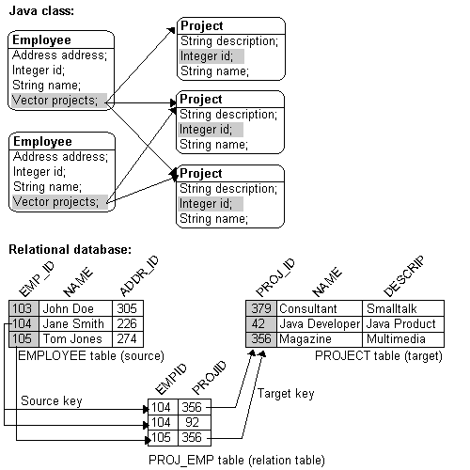

Slide 54
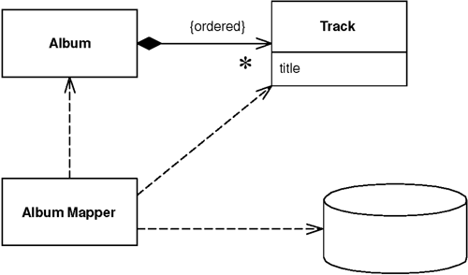
Dependent Mapping
One class perform the database mapping for a child class.
A dependent must have exactly one owner.
There must be no references from any object other than the owner to the dependent.
Depended item does not need their own identity.

Slide 55
Embedded Value
Maps an object into several fields of another object's table.
Many small objects make sense in an OO system that don't make sense as tables in a database.
An Embedded Value maps the values of an object to fields in the record of the object's owner.
Simple value objects with out their own identity (money,data).
Small and fixed number of dependent objects.
Has object any relevant outside the context of owner?

Slide 56
Serialized LOB
Saves a graph of objects by serializing them into a single large object (LOB), which it stores in a database field.
Object contain complicated graph of small objects. They have no sense outside the context of big object. There is no references to objects inside LOB from object outside LOB and vice versa.
We can chop out a piece of the object model and use it to represent the LOB. LOB represents a bunch of objects that aren't likely to be queried from any SQL route outside the application.
Binary LOB vs. XML LOB.

Slide 57
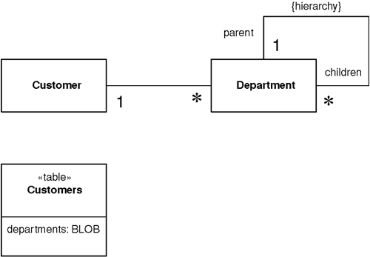

Slide 58
Single Table Inheritance
Represents an inheritance hierarchy of classes as a single table that has columns for all the fields of the various classes.
There's only a single table to worry about on the database.
There's only a single table to worry about on the database.
There's only a single table to worry about on the database.
Fields are sometimes relevant and sometimes not, which can be confusing to people using the tables directly.
Columns used only by some subclasses lead to wasted space in the database.
The single table may end up being too large, with many indexes and frequent locking, which may hurt performance.
You only have a single namespace for fields, so you have to be sure that you don't use the same name for different fields.

Slide 59
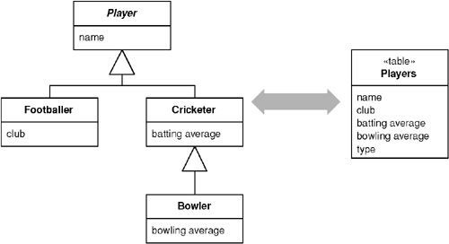

Slide 60
Class Table Inheritance
Represents an inheritance hierarchy of classes with one table for each class.
How to link the corresponding rows of the database tables?
How to bring the data back from multiple tables in an efficient manner? Which tables join?
All columns are relevant for every row so tables are easier to understand and don't waste space.
The relationship between the domain model and the database is very straightforward.
You need to touch multiple tables to load an object, which means a join or multiple queries and sewing in memory.
Any refactoring of fields up or down the hierarchy causes database changes.
The supertype tables may become a bottleneck because they have to be accessed frequently.
The high normalization may make it hard to understand for ad hoc queries.

Slide 61
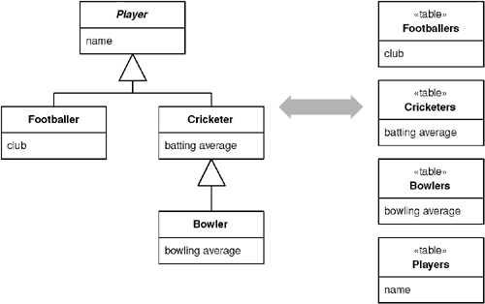

Slide 62
Concrete Table Inheritance
Represents an inheritance hierarchy of classes with one table per concrete class in the hierarchy.
Each table contains columns for the concrete class and all its ancestors, so any fields in a superclass are duplicated across the tables of the subclasses.
Searching for object in supersclass means searching for objects in all concerete subclasses. Problem with queries when new subclass is added.
Key uniqueness across tables for identity maping (primary key and table name).
Problems with referential integrity in the database

Slide 63
Each table is self-contained and has no irrelevant fields.
There are no joins to do when reading the data from the concrete mappers.
Each table is accessed only when that class is accessed, which can spread the access load.
Primary keys can be difficult to handle.
You can't enforce database relationships to abstract classes.
If the fields on the domain classes are pushed up or down the hierarchy, you have to alter the table definitions.
If a superclass field changes, you need to change each table that has this field because the superclass fields are duplicated across the tables.
A find on the superclass forces you to check all the tables, which leads to multiple database accesses (or a weird join).

Slide 64
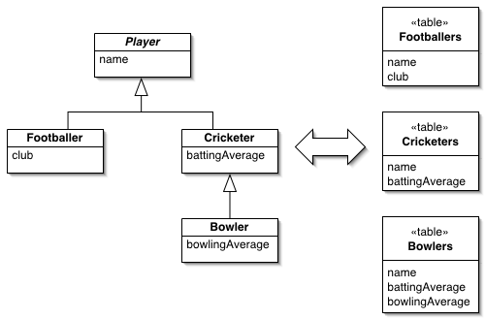

Slide 65
Inheritance Mappers
A structure to organize database mappers that handle inheritance hierarchies.
One point where the mapping can be changed.
A structur to organize Finds and queries.
Class specified insertion and deletion by polimorphism.

Slide 66
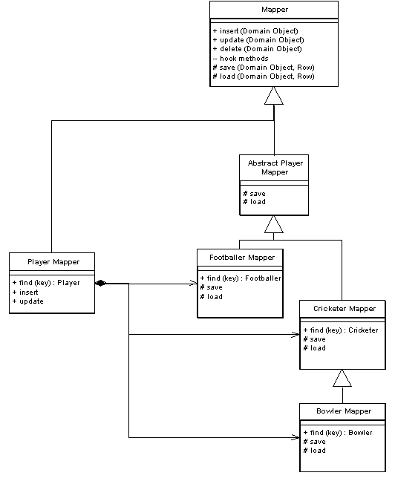

Slide 67
Object-Relational Metadata Mapping Patterns
Metadata Mapping - holds details of object-relational mapping in metadata.
Automatic code generation and mapping by reflection. NHibernate.
Query Object - an object that represents a database query. Interpreter pattern. Keeping database schemas encapsulated, supporting multiple schemas, and optimizing to avoid multiple queries.
Repository - mediates between the domain and data mapping layers using a collection-like interface for accessing domain objects.

Slide 68
Offline Concurrency Patterns
Bussiness transaction vs. Database transaction.
Bussiness transaction spaned on multiple sessions.

Slide 69
Optimistic Offline Lock
Prevents conflicts between concurrent business transactions by detecting a conflict and rolling back the transaction.
Validation the changes about to be committed by one session don't conflict with the changes of another session.
Assumption that the chance of conflict is low.
Conflict lead to problems with changes integration (manual merge, auto merge, changes throw out).
Reader could have out of date datas.
Does not reduce concurrency.
Easy implementation. Version number.
Perforce.

Slide 70
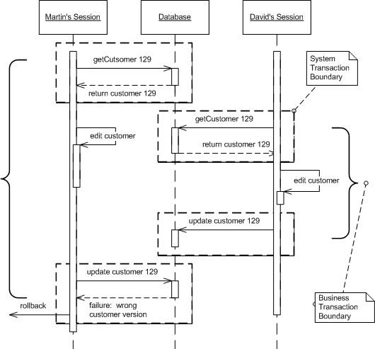

Slide 71
Pessimistic Offline Lock
Prevents conflicts between concurrent business transactions by allowing only one business transaction at a time to access data.
Assumption that the chance of conflict is high.
Pessimistic lock is about conflict prevention.
Reduces concurrency.
Exclusive write lock – many reader, reader could have out of date data.
Exclusive read lock - one reader or one writer.
Read/write lock - read and write locks are mutually exclusive; concurrent read locks are acceptable; the existence of a single read lock prevents any business transaction from editing the record.
Deadlocks.

Slide 72
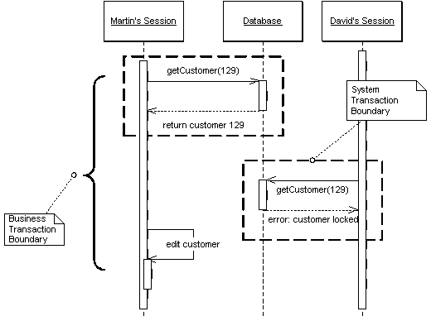

Slide 73
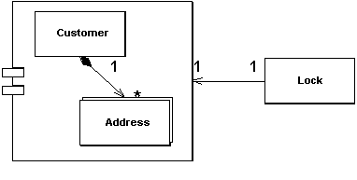
Coarse-Grained Lock
Locks a set of related objects with a single lock.
Object edited as a group.
Performance.

Slide 74
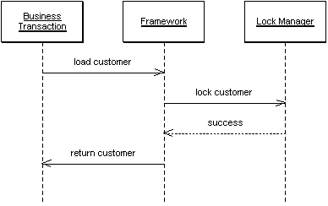
Implicit Lock
Allows framework or layer supertype code to acquire offline locks.
Prevents gaps in lock scheme.

Slide 75
Session states

Slide 76
Client Session State
Stores session state on the client.
Supporting stateless server objects with maximal clustering and failover resiliency.
If the client fails all is lost. Good luck if user expects that.
With large amounts of data the issues of where to store the data and the time cost of transferring everything with every request become prohibitive.
Security issue.

Slide 77
Server Session State
Keeps the session state on a server system in a serialized form.
Session maintenance problems.
Scaliability problems.

Slide 78
Database Session State
Stores session data as committed data in the database.
Session maintenance problems, detection when client abandons session.
Data base access cost.

Slide 79
Distribution Patterns

Slide 80
Remote Fasade
Provides a coarse-grained facade on fine-grained objects to improve efficiency over a network.
Request agregation for improvment performance. Reduction communication cost.
Interface optimized for certain scenarios.
Decoupling service implementation code from service interface.
Increase amount of work required to make change in exposed functionality.
Different functionality for different consumers.
Synchronous vs. asynchronous.

Slide 81
Data Transfer Object
An object that carries data between processes in order to reduce the number of method calls.
Data transfer throug network is slow.
We need to transfer multiple items of data between two processes in a single method call.
Object interface with fine grained method for manipulation on object datas.
Service interface optimized for remote calls.
Possible class explosion.
Additional computation.
Serialization/compression.
What to do with references to other objects?

Slide 82
